Slide 1
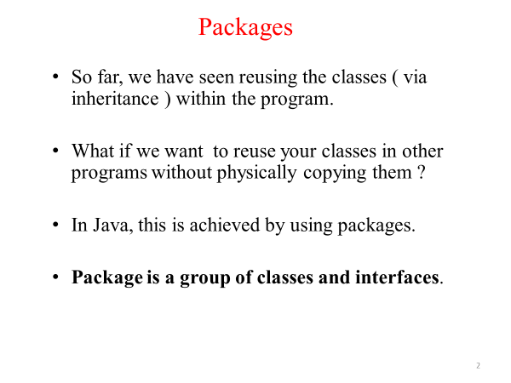

Slide 2
Defining Packages in java
In java, a package is a container of classes, interfaces, and sub-packages. We may think of it as a folder in a file directory.
We use the packages to avoid naming conflicts and to organize project-related classes, interfaces, and sub-packages into a bundle.
In java, the packages have divided into two types.
Built-in Packages
User-defined Packages
Built-in Packages
The built-in packages are the packages from java API. The Java API is a library of pre-defined classes, interfaces, and sub-packages. The built-in packages were included in the JDK.
There are many built-in packages in java, few of them are as java, lang, io, util, awt, javax, swing, net, sql, etc.

Slide 3
Java Built-In Packages
We need to import the built-in packages to use them in our program. To import a package, we use the import statement.
There are six built-in packages :
java.lang
Contains classes for Strings, Math functions, Threads, and Exception
java.util
Contains classes such as Scanner, Vector,date, Calendar etc.
java.io
Stream classes for I/O
java.awt
Classes for implementing GUI – Windows, Buttons, Menus etc.
java.net
Classes for Network programming
Java.sql
Classes for Database accessing.
java.applet
Classes for creating and implementing applets

Slide 4
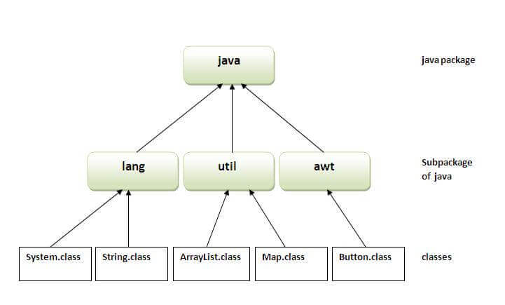
Java package hierarchy

Slide 5
User-defined Packages
The user-defined packages are the packages created by the user. User is free to create their own packages.
Defining a Package in java
We use the package keyword to create or define a package in java programming language.
Syntax
package packageName;
🔔 The package statement must be the first statement in the program.
🔔 The package name must be a single word.
🔔 The package name must use Camel case notation.

Slide 6
Advantage of Java Package
1) Java package is used to categorize the classes and interfaces so that they can be easily maintained.
2) Java package provides access protection.
3) Java package removes naming collision.
Let's consider the following code to create a user-defined package myPackage.
package myPackage;
public class DefiningPackage {
public static void main(String[] args) {
System.out.println("This class belongs to myPackage.");
}
}

Slide 7
How to access package from another package?
There are three ways to access the package from outside the package.
import package.*;
import package.classname;
fully qualified name.

Slide 8
1) Using packagename.*
If you use package.* then all the classes and interfaces of this package will be accessible but not subpackages.
The import keyword is used to make the classes and interface of another package accessible to the current package.
Example of package that import the packagename.*
//save by A.java
package pack;
public class A{
public void msg()
{
System.out.println("Hello");
}
}
//save by B.java
package mypack;
import pack.*;
class B{
public static void main(String args[]){
A obj = new A();
obj.msg();
}
}
Output:Hello

Slide 9
2) Using packagename.classname
If you import package.classname then only declared class of this package will be accessible.
Example of package by import package.classname
//save by A.java
package pack;
public class A{
public void msg()
{
System.out.println("Hello");}
}
//save by B.java
package mypack;
import pack.A;
class B{
public static void main(String args[])
{
A obj = new A();
obj.msg();
}
}
Output:Hello

Slide 10
3) Using fully qualified name
If you use fully qualified name then only declared class of this package will be accessible. Now there is no need to import. But you need to use fully qualified name every time when you are accessing the class or interface.
//save by B.java
package mypack;
class B{
public static void main(String args[]){
pack.A obj = new pack.A();//using fully qualified name
obj.msg();
}
}
Output:Hello
Example of package by import fully qualified name
//save by A.java
package pack;
public class A{
public void msg(){System.out.println("Hello");}
}

Slide 11
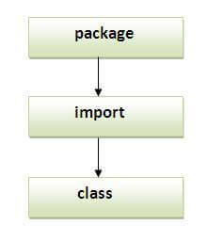
Sequence of the program must be package then import then class

Slide 12
/* File name : Animal.java */
package animals;
interface Animal {
public void eat();
public void travel();
}
package animals;
/* File name : MammalInt.java */
public class MammalInt implements Animal {
public void eat() {
System.out.println("Mammal eats");
}
public void travel() {
System.out.println("Mammal travels");
}
public int noOfLegs() {
return 0;
}
public static void main(String args[])
{
MammalInt m = new MammalInt();
m.eat();
m.travel();
}
}
Output:
Mammal eats
Mammal travels

Slide 13
Sub Package in Java
Package inside the package is known as subpackage.
The packages that come lower in the naming hierarchy are called "sub package" of the corresponding package higher in the hierarchy i.e. the package that we are putting into another package is called "sub package".
The naming convention defines how to create a unique package name so that packages that are widely used with unique namespaces.
This allows packages to be easily managed. Suppose we have a file called "HelloWorld.java". and want to store it in a sub package "subpackage", which stays inside package "package1".
The "HelloWorld" class should look something like this:

Slide 14
package package1.subpackage;
public class HelloWorld {
public void show(){
System.out.println("This is the function of the class HelloWorld!!");
}
}
Now import the package "subpackage" in the class file "CallPackage"
import package1.subpackage.*;
class CallPackage{
public static void main(String[] args){
HelloWorld h2=new HelloWorld();
h2.show();
}
}

Slide 15
C:\atnyla\package1\subpackage\HelloWorld.java
C:\atnyla\package1\subpackage>cd..
C:\atnyla\package1>cd..
C:\atnyla>javac CallPackage.java
C:\nisha>java CallPackage
This is the function of the class HelloWorld!!

